Slide 1
Final Assignment
Divyansh Sharma
Factitious disorders
Abnormal Psychology GNED 2035
Professor: Meredith Lowe
April 23, 2018

Slide 2

Overview
a serious mental disorder in which someone tricks others by appearing sick, by purposely getting sick or by self-injury.
challenging to recognize and hard to treat.
previously mentioned to as Munchausen syndrome.
Types:
Factitious disorder imposed on self
Factitious disorder imposed on another
Although people with factitious disorder know they are causing their symptoms or illnesses, they may not understand the reasons for their behaviors or recognize themselves as having a problem.

Slide 3
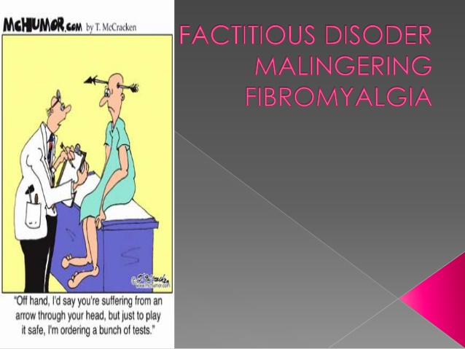
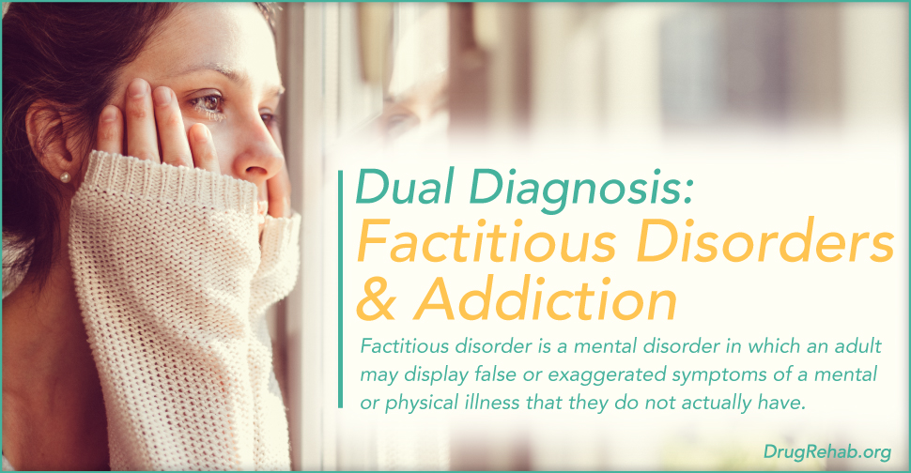
Types
Factitious disorder imposed on self: refers to the psychiatric condition in which patients deliberately produce or falsify symptoms and/or signs of illness for the principal purpose of assuming the sick role.
Factitious disorder imposed on another: In this mental illness a person acts as if an individual he or she is caring for has a physical or mental illness when the person is not really sick. In this disorder, a person produces or lies about illness in another person under his or her care, usually a child under 6 years of age. It is considered a form of abuse by the American Professional Society on the Abuse of Children.

Slide 4
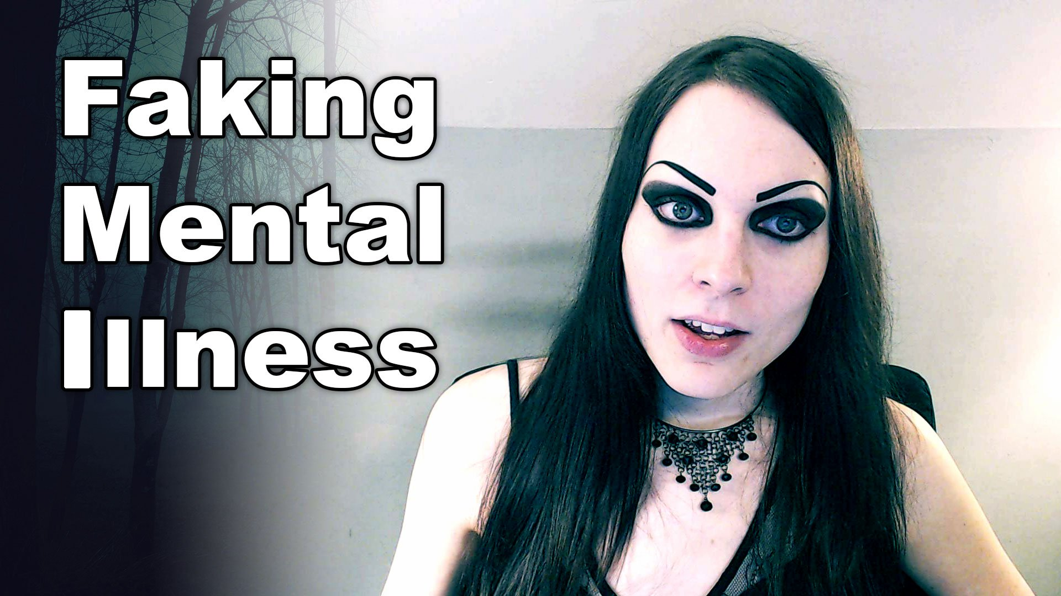
Causes
Exact cause is still unknown.
biological and psychological factors responsible to some extent.
Abuse, neglect, or abandonment during childhood.
history of frequent illnesses may also cause this disorder.
Another cause is a history of close relationship with some friend or family member who had a severe or chronic condition.

Slide 5
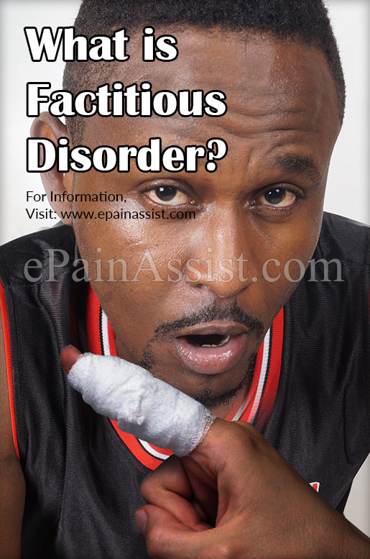
Symptoms of disorder
Presence of many surgical scars.
Presence of new or other symptoms following negative test results.
Arguing with doctors and staff
Frequent stays in the hospital
Hesitancy to allow doctors to interact to family or friends or to other health care specialists.
Looking for treatment from many different doctors or hospitals, which may include using a fake name.
Conditions that don't respond as expected to standard therapies

Slide 6

Ganser syndrome
considered a separate factitious disorder
disorder of extreme stress or an organic condition.
patient suffers from approximation or giving illogical answers to simple questions.
Very rare with less than 100 recorded cases.

Slide 7
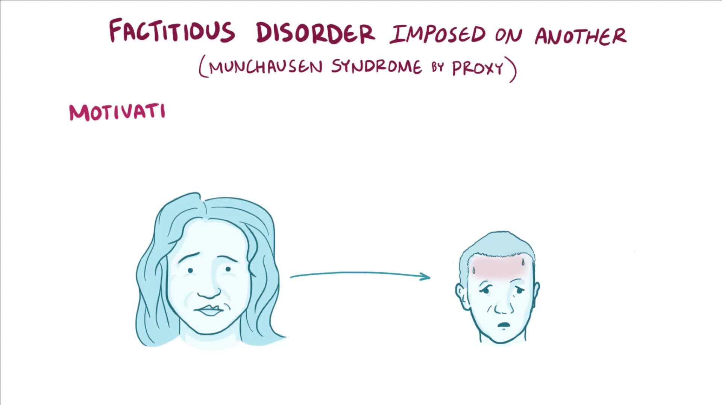
Treatment
Treatment of factitious disorder is often hard, and there is no therapy yet to solve the problem. Because people with factitious disorder want to be in the sick role, they're often unwilling to seek or accept treatment for the disorder.
However, if approached in a gentle, nonjudgmental way, a person with factitious disorder may agree to be treated by a mental health professional. Medications can be used to treat mental health disorders, such as depression or anxiety. Psychotherapy, behavior therapy and family therapy may help to control stress.

Slide 8
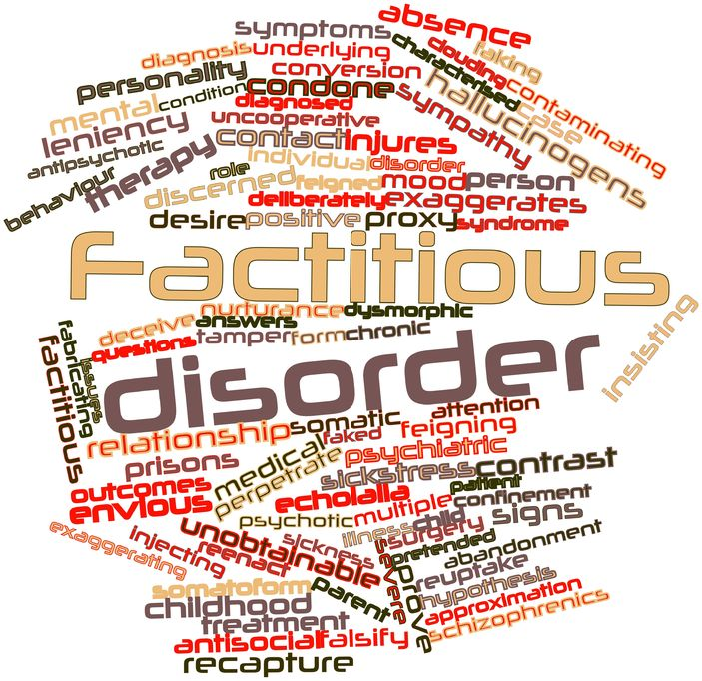
Diagnosis
Is very difficult because patients fake many different diseases and conditions.
Doctors can suspect, check or diagnose by:-
Asking patients for previous medical records.
Asking family members for more information.
If patient displays no convincing reason exists for an illness or injury.
If the person is caught in the act of lying or causing an injury.
inconsistent symptoms or lab test results.

Slide 9
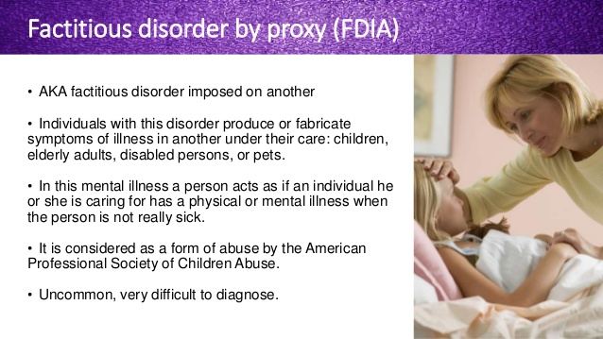
Why people fake serious illnesses?
https://www.youtube.com/watch?v=I8H5QtYQWlc

Slide 10
Complications
People with factitious disorder are try to be seen as sick as a result they risk their lives. They can have other mental disorders as well. So patients face many complications like:
Injury or death from self-inflicted medical conditions.
Health problems or unnecessary surgery or other procedures.
Alcohol or excessive drug abuse.
daily problems, relationships or work related problem.

Slide 11
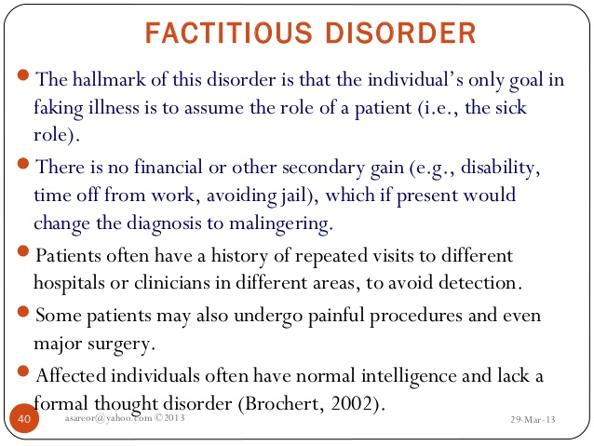

Slide 12
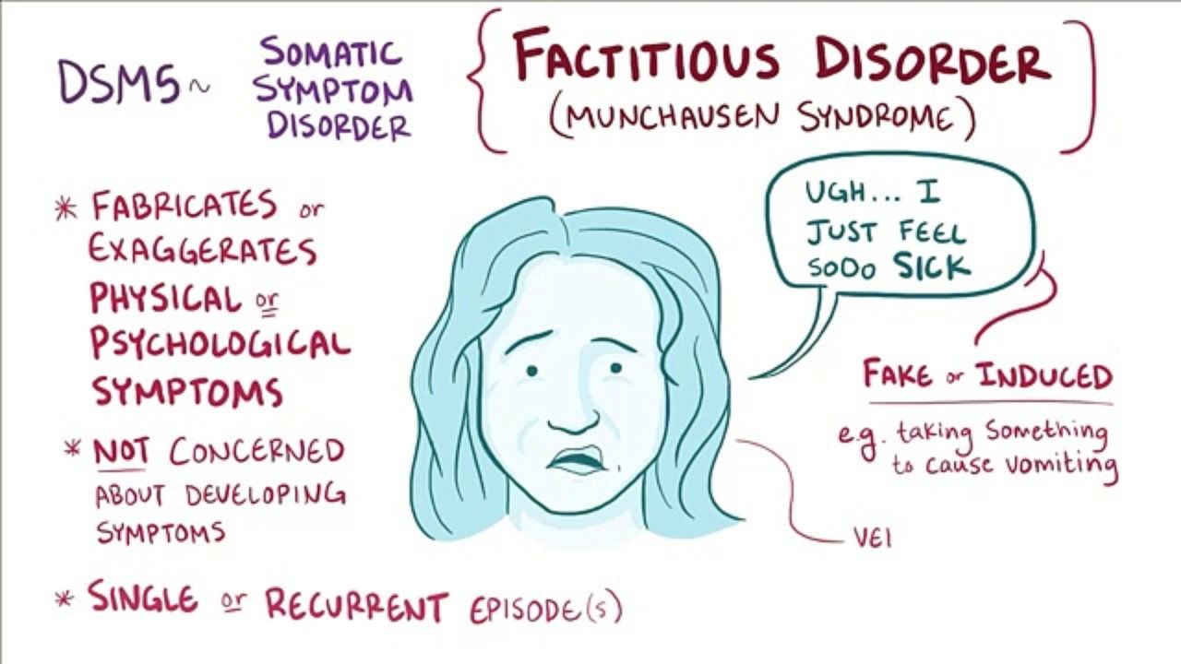

Slide 13
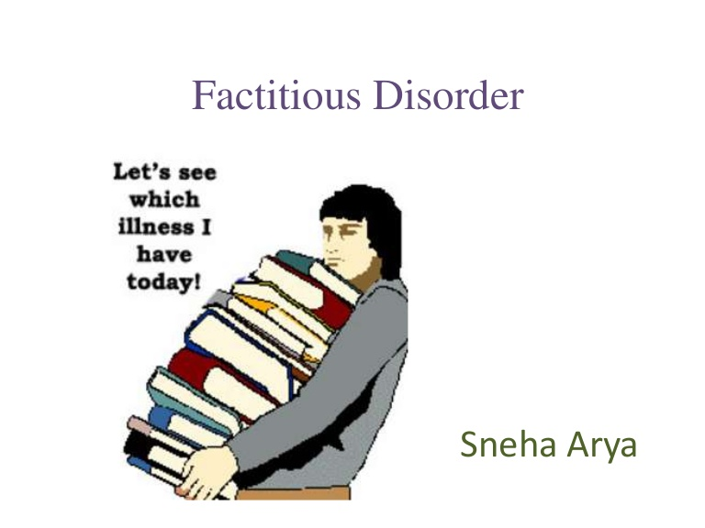
Conclusion
Factitious disorders are rare but serious illnesses that present diagnostic and management problems. Getting proper and accurate information about these illnesses is a major issue. Professionals and doctors should now be more alert about this disorder so that they can perform proper diagnosis with patients.

